Slide 1
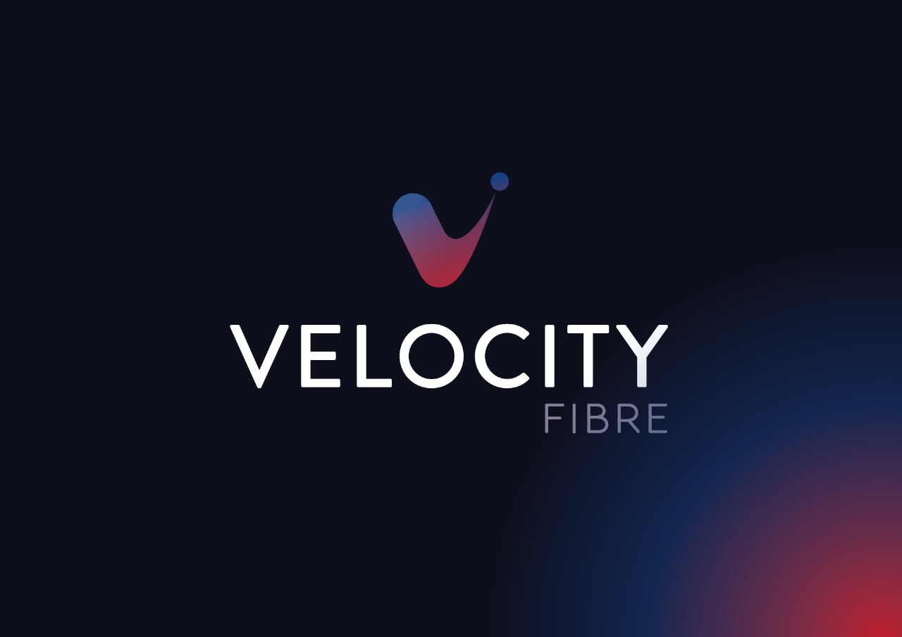

Velocity Fibre:
Connecting Communities, Empowering Futures

Slide 2


Strategic Overview
Core Business: End-to-end fibre infrastructure development and maintenance — from design and planning to full turnkey build, transfer, and long-term network operations.
Market Position: Approved build partner to two of South Africa’s largest Fibre Network Operators (FNOs), currently holding purchase orders for over 250 000 home connections.
Vision: To become Africa’s leading independent fibre delivery and management partner, connecting communities and driving digital inclusion under the banner “Connecting Communities, Empowering Futures.”

Slide 3


Scale and Financial Potential
High-Growth Pipeline: Immediate visibility on projects exceeding R2.5 billion in gross build value over the next 24 months.
Financial Model Highlights:
Forecast 5 082 activations to break even under conservative assumptions.
Expected gross profit margins of 40 % on fibre build contracts, with scalable expansion to 35 % under optimised supplier terms.
Monthly optical activations: Target 500 new homes/month, ramping to 1 000 + by Q2 2026.
3 % financing cost coverage ensures sustainable cash-flow headroom.
Revenue Stability: Balanced Build-and-Transfer (CAPEX) and Maintenance (OPEX) models generate recurring and project-based income.
Long-Term Upside: National and pan-African expansion opportunities leveraging proven project frameworks.

Slide 4

Execution Strength
Track Record:
Over 30 million metres of fibre successfully installed and commissioned
Operational teams with nationwide coverage for mechanical and hand trenching, aerial fibre installation, and certified splicing/testing.Project
Project Management Excellence: End-to-end oversight from planning through quality assurance, ensuring international compliance and timely delivery.
Supplier Ecosystem: 15–16 strategic supplier relationships under renegotiation to optimise cash cycles and reduce capex pressure
Quality & Reliability: Established 24/7 maintenance operations and rapid-response field teams for last-mile customer connections.

Slide 5
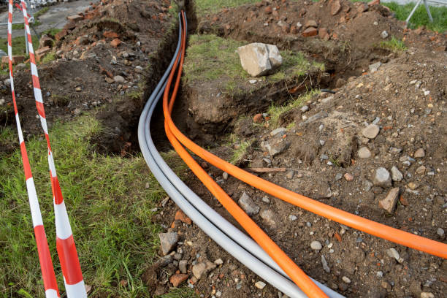
Competitive Advantages
Turnkey Delivery Partner: Proven capability to execute FTTH, FTTB, and MDU networks at scale, from design to handover.
Operational Efficiency: Integrated real-time financial tracking tied to activation data for agile rollout control
Community-Focused Model: Prioritizes local employment, training, and socio-economic development in every deployment zone.
Strategic Relationships: Active engagement with major FNOs, municipalities, and infrastructure investors for expansion and joint-venture opportunities.
Strong Leadership: Management team with decades of combined experience in telecom infrastructure (Blitz Fibre, Frogfoot, ZTE)

Slide 6

Investment Opportunity
Capital Requirement: Strategic equity or convertible instrument to scale rollout capacity and working-capital lines for 250 000 + home connections.
Investor Value Proposition:
Early entry into a high-margin, recession-resilient infrastructure asset class.
Direct participation in Africa’s broadband acceleration phase.
Clear path to 10 × valuation growth within 3–5 years based on contracted demand and projected activations.
Exit Potential: Institutional acquisition or FNO buy-out at mature deployment stage, underpinned by secured long-term maintenance contracts.

Slide 7

Key Metrics at a Glance
Metric | Value / Target
Active FNO Clients | 2 (Tier-1 National Operators)
Purchase Orders | 250 000 Homes
Gross Profit Margin | 40% +
Current Activation Rate | 800 / month /project
Fibre Installed to Date as a team | 30 Million Metres +
Supplier Base | 15–16 Key Partners
Monthly OPEX | Stable, flatline growth
EBITDA Target 2026 | ± 200 Million

Slide 8



Competitive Advantages: Why Choose Us?
Global Reach
Industry Expertise
Strategic Partnerships
International service delivery across UK, Europe, USA, and Africa
Our team is comprised of industry veterans with years of expertise.
Relationships with major network operators

Slide 9



Competitive Advantages: Why Choose Us?
Financial Independence
Comprehensive Solutions
Community Focus
Self-funded model offers unparalleled financial flexibility, allowing for swift execution without the constraints of third-party capital
Commitment to uplift rural and low-income communities through connectivity
End-to-end service delivery capability

Slide 10

What questions do you have for us?
Feel free to reach out anytime for more information!
projects@velocityfibre.co.za

